Slide 1
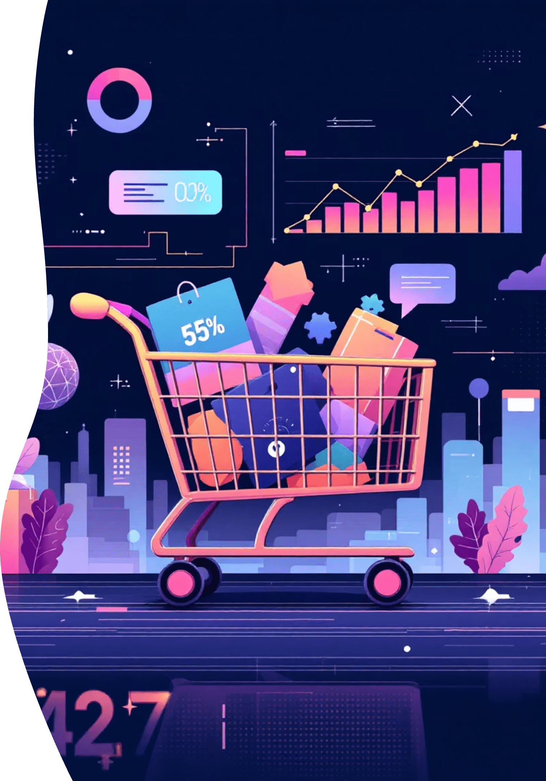
Customer Shopping Behavior Analysis
Uncovering insights from transactional data to guide strategic business decisions.

Slide 2

Project Overview
Analyze 3,900 Purchases
Uncover Key Insights
Spending patterns, customer segments, product preferences.
Transactional data across diverse product categories.
Guide Strategy
Inform business decisions with data-driven recommendations.

Slide 3

Dataset Summary
Our dataset comprises 3,900 rows and 18 columns, offering a rich view into customer behavior.
Rows: 3,900
Columns: 18
Missing Data: 37 values in Review Rating
Key Features
Customer demographics (Age, Gender, Location, Subscription Status), Purchase details (Item, Category, Amount, Season, Size, Color), Shopping behavior (Discount, Promo Code, Previous Purchases, Frequency, Review Rating, Shipping Type).

Slide 4
Exploratory Data Analysis (Python)
We initiated our analysis with comprehensive data preparation and cleaning using Python.
01
02
03
Data Loading & Exploration
Missing Data Handling
Column Standardization
Imported dataset with pandas; checked structure and summary statistics.
Imputed missing 'Review Rating' values using median per product category.
Renamed columns to snake case for readability.
04
05
Feature Engineering
Data Consistency & Integration
Created 'age_group' and 'purchase_frequency_days' columns.
Dropped redundant 'promo_code_used'; loaded cleaned data to PostgreSQL.

Slide 5

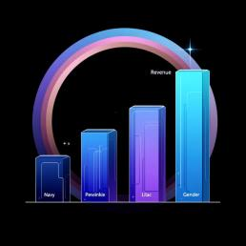
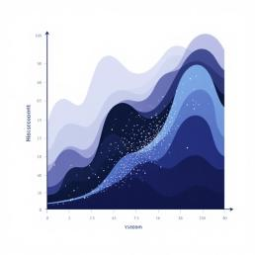
SQL Analysis: Revenue & Discounts
Structured analysis in PostgreSQL revealed key business insights.
Revenue by Gender
High-Spending Discount Users
Compared total revenue generated by male vs. female customers.
Identified customers who used discounts but spent above average.

Slide 6


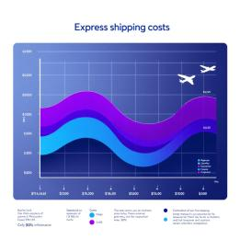
SQL Analysis: Product & Shipping
Further SQL queries provided insights into product performance and shipping preferences.
Top 5 Products by Rating
Shipping Type Comparison
Found products with the highest average review ratings.
Compared average purchase amounts between Standard and Express shipping.

Slide 7

SQL Analysis: Subscription & Discounts
Understanding the impact of subscriptions and discounts on customer behavior.
1
2
Subscribers vs. Non-Subscribers
Discount-Dependent Products
Compared average spend and total revenue across subscription statuses.
Identified 5 products with the highest percentage of discounted purchases.

Slide 8


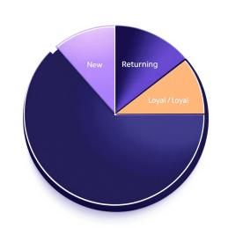
SQL Analysis: Customer Segmentation
Classifying customers and identifying top products within categories.
Customer Segmentation
Top 3 Products per Category
Classified customers into New, Returning, and Loyal segments based on purchase history.
Listed the most purchased products within each category.

Slide 9
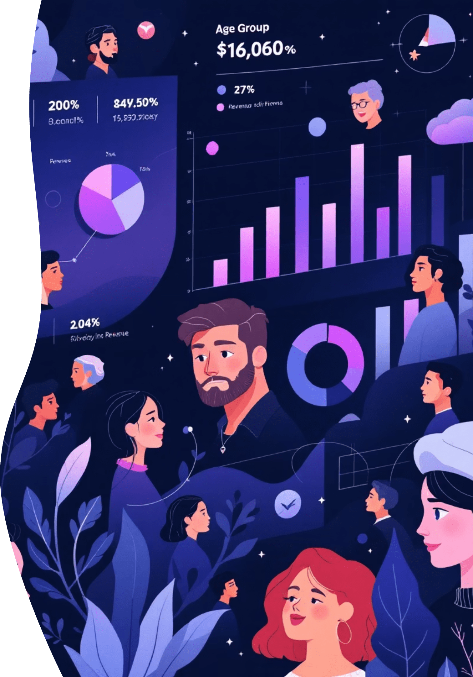
SQL Analysis: Loyalty & Demographics
Examining repeat buyers and revenue contributions by age group.
Repeat Buyers & Subscriptions
Checked if customers with >5 purchases are more likely to subscribe.
Revenue by Age Group
Calculated total revenue contribution of each age group.

Slide 10





Business Recommendations
Boost Subscriptions
Promote exclusive benefits for subscribers.
Customer Loyalty Programs
Reward repeat buyers to foster loyalty.
Review Discount Policy
Balance sales boosts with margin control.
Targeted Marketing
Focus efforts on high-revenue age groups and express-shipping users.

